Slide 1


Bapuji Educational Association®
Bapuji Institute of Engineering and Technology
Davangere-577 004
Department of Electronics & Communication Engineering
A Presentation on Mini Project :
Automatic Subway Ticketing System using Verilog
Project Associates
A S PRUTHI 4BD21EC001
ABDUL KHADAR JILANI 4BD21EC003
ADITYA A CHAWAN 4BD21EC005
AKASH R M 4BD21EC007
Dr. SHUBHA V PATEL Dr.G S SUNITHA
M.Tech.,Ph.D.,MISTE. M.Tech.,(DEAC),Ph.D.,MISTE., FIETE.,FIE.
Mini Project Guide Program Coordinator

Slide 2
BAPUJI INSTITUTE OF ENGINEERING AND TECHNOLOGY, DAVANGERE-577004
Vision of the Institute
To be a centre of excellence recognized nationally and internationally, in distinctive areas of engineering education and research, based on a culture of innovation and invention.
Mission of the Institute
BIET contributes to the growth and development of its students by imparting a broad based engineering education and empowering them to be successful in their chosen field by inculcating in them positive approach, leadership qualities and ethical values.

Slide 3
Department of Electronics and Communication Engineering
Vision of the Department
To be in the forefront in providing quality technical education and research in Electronics & Communication Engineering to produce skilled professionals to cater to the challenges of the society.
Mission of the Department
To facilitate the students with profound technical knowledge through effective teaching learning process for a successful career.
To impart quality education to strengthen students to meet the industry standards and face confidently the challenges in the programme.
To develop the essence of innovation and research among students and faculty by providing infrastructure and a conducive environment.
To inculcate the student community with ethical values, communication skills, leadership qualities, entrepreneurial skills and lifelong learning to meet the societal needs.

Slide 4
Course Learning Objectives
This course will enable students to
Understand and analyze an engineering problem.
Acquire technical knowledge and collect the information.
Enhance communication, technical presentation and report preparation skills.
Provide an opportunity to exercise the creative and innovation ideas in group.

Slide 5
Abstract
This work presents the design and implementation of an Automatic Subway Ticketing System using Verilog. The system employs a Finite State Machine (FSM) model to manage states such as coin insertion, ticket dispensing, and difference amount return. It accepts various coin denominations, ensuring accurate fare calculation and difference amount dispensing. The Verilog-based design include modules of different routes with respective fare.Verilog modules were designed based on the FSM’s of different routes.
The project showcases the functionality of digital design principles and Verilog programming in creating a reliable and efficient ticketing system.

Slide 6
Table of Contents
Introduction
Objective
Problem Statement
Literature Review
Methodology
Working
Design and Implementation
Verilog code for Design and Testbench Code
Results
Generated Reports
Applications
Advantage and Limitations
Future Scope
Conclusion
References
Course Outcomes

Slide 7
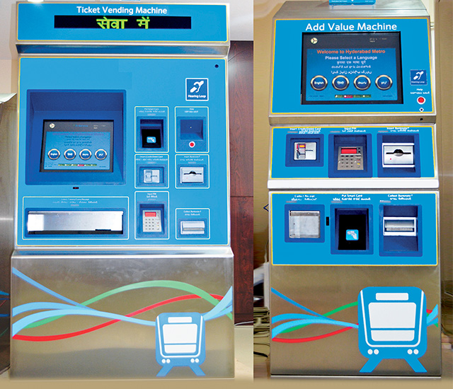
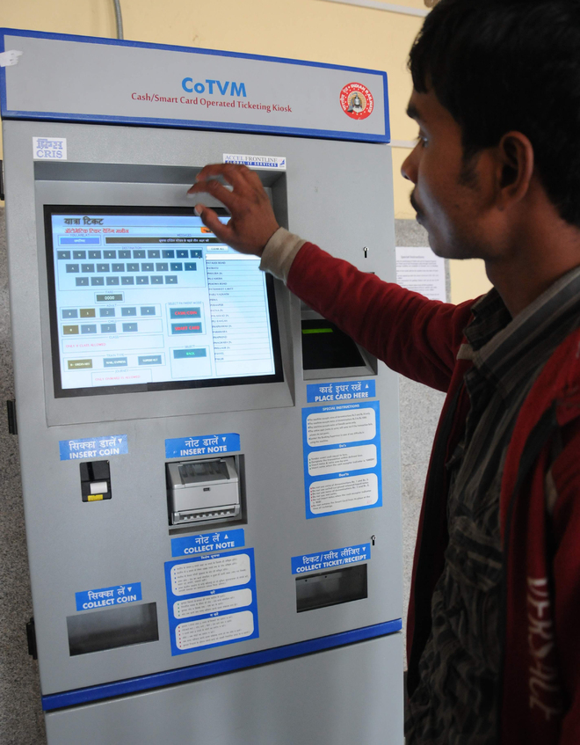
1. Introduction
-Project Overview
-Objective
*Related images (Source: wikipedia)

Slide 8
Project Overview : Automatic Subway Ticketing System
Purpose and Scope of the Project: Automatic Subway Ticketing System Using Verilog
Purpose:
The primary purpose of the Automatic Subway Ticketing System using Verilog is to design and implement a digital, automated solution for purchasing subway tickets. This system aims to streamline the ticketing process, reduce human error, and enhance the efficiency and convenience of subway operations. The goals are:
Efficiency: Automate ticket purchasing and validation to reduce waiting times and improve passenger flow.
Accuracy: Minimize human errors in ticket transactions through automated processes.
Convenience: Provide a user-friendly interface for passengers to purchase and validate tickets with ease.
Scalability: Design a flexible system that can be easily updated to accommodate new ticket types, and system enhancements.

Slide 9
Scope:
The scope of the Automatic Subway Ticketing System project includes the following key areas:
User Interface:
Implementation of input mechanisms (buttons) for users to select ticket types, quantities, and payment methods.
Ticket Options:
Support for multiple routes subway’s ticket.
Payment Processing:
Payment done through a cash and difference amount will be dispensed along with the ticket.
Verilog Implementation:
Coding of the entire system in Verilog, ensuring proper communication and integration between different modules.
Utilization of Finite State Machines (FSM) to manage the sequence of operations and states in the ticketing process for maximum possibilities.

Slide 10
5. Testing and Validation:
Creation of comprehensive test benches to simulate different scenarios and validate system behavior.
Execution of tests under normal and edge conditions to ensure reliability and robustness.
6. Synthesis and Report Generation:
Schematic synthesis and Generation of reports with respect to the area, power, gate, Quality of Result(QoR).

Slide 11
2. Objective
The objective of this mini-project are:
1. To design and implement an automatic subway ticketing system using Verilog.
2. Enhancing the functionality to operate for multiple denomination and difference amount dispensing.
3. To synthesize the design and generating comprehensive reports on area, gate count, quality of results (QoR), timing, and power, and detailed analysis of the reports to ensure optimal performance and efficiency.

Slide 12
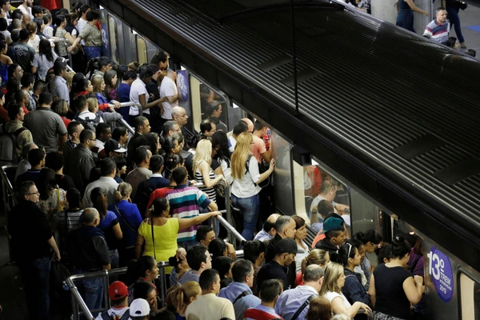
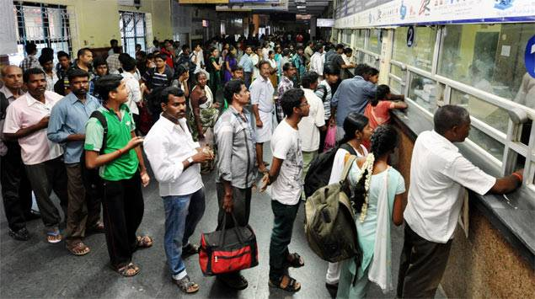
3. Problem Statement
Ticket dispensing become a challenging task in nowadays due increased number of Passengers.Hence, there is need for automatic subway ticketing system for passenger convenience.
This challenge can be addressed with available technologies
*Related Images (Source: Google Images)

Slide 13
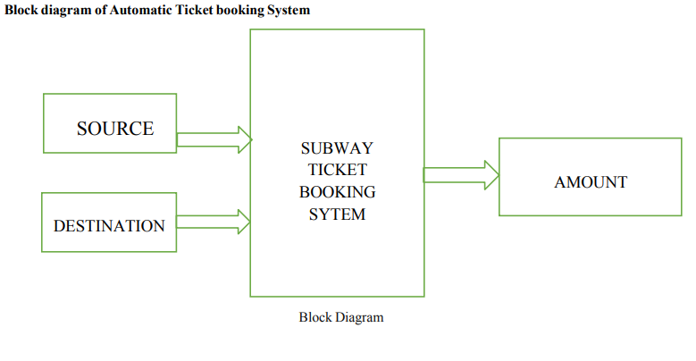
4. Literature Review
Previous work:
A Subway Automatic Ticket Booking System implemented using Verilog is like a smart machine that helps people buy tickets for subway rides. Verilog is a special computer language used to program electronic devices. In this system, when a passenger wants to purchase a subway ticket, they interact with the machine by pressing buttons or touching a screen.
The Verilog algorithm inside the machine processes their choices and calculates the fare. This process is quick and efficient, making it easy for people to get their subway tickets without the need for human intervention. It's like a digital ticket vending machine that simplifies the ticket-buying process for subway passengers
Gap Analysis:
Previously modeled Automatic Subway Ticketing System (ASTS) does not offer flexibility in dispensing different amounts or in adding more routes

Slide 14
Summary of the Literature Survey
TITLE | AUTHOR | PUBLISHED IN | METHODOLOGY | LIMITATION
Design of Vending Machine Using Verilog HDL. | A. Krishna Kumar G. Ashritha D. Deepika | 2018 | Model of a sequential machine has inputs, outputs and internal states. | Fixed coin denominations
Design and implementation of subway automatic ticketing system based on Verilog HDL. | Liu ZiXuan Li Chao Yang Guo Yuan | 2022 | The paper also simulates the ticket selection module, coin calculation module, change processing module and display interface module on Quartus II 13.1. | Scalability, flexibility, integration, and Poor possibility coverage
Design of a Vending Machine Using Verilog HDL and Implementation in Genus & Encounter. | Mahamudul Hassan Fuad, Rahbar Yeassin, K. M. Mehedi Hassan, Md Mahmudunnabi Sykot, and Md Faysal Nayan | 2023 | Design, implementation, and verification of a vending machine using the Finite State Machine (FSM) methodology in Verilog HDL. | Does not offer flexibility in dispensing different amounts or in adding more products.

Slide 15
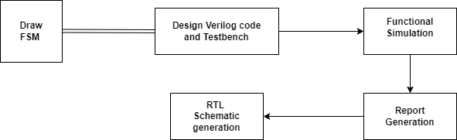
5. Methodology
Tools and Technologies
Operating System : Linux
Cadence tool
For functional simulation : Incisive simulator
For synthesis : Genus Tool
Workflow
Fig. Block diagram shows the workflow of the project

Slide 16
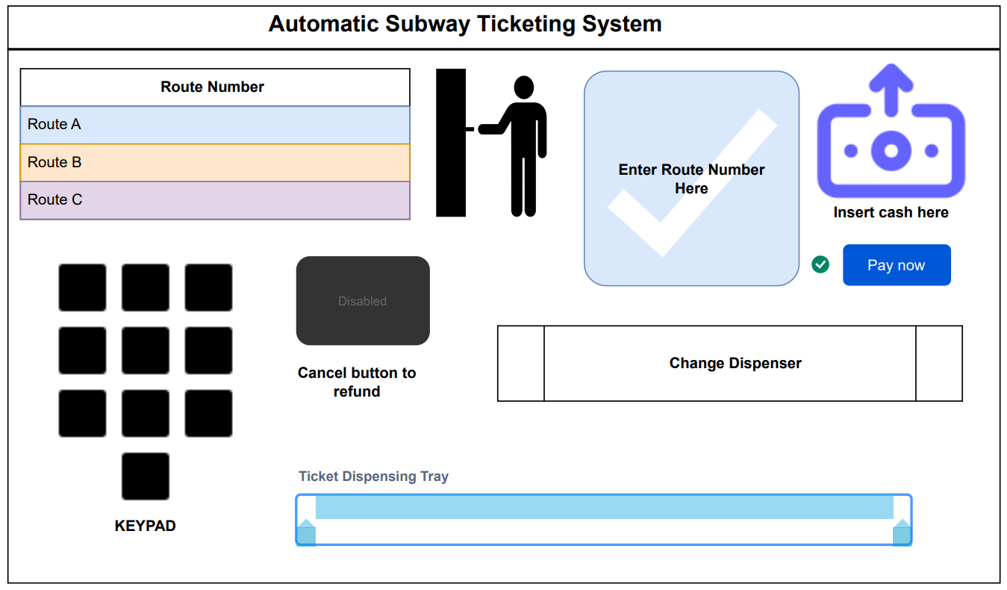
6. Working

Slide 17
Working
The project involved designing a vending machine that could dispense ticket for four different routes with varying prices and has the additional feature of returning change when a higher denomination coin was inserted.
Designed vending machine only accepts coins of denominations five and ten.
The design of the vending machine was accomplished through the creation of a Finite State Machine (FSM) model, which defines the machine's different states, inputs, and outputs, as well as the transitions between the states.
The FSM model was implemented using Verilog code, which defines the different states and their corresponding logic for accepting coins, dispensing products, and returning change.
A test-bench was created to simulate different scenarios, such as different coin denominations and product selections, to ensure that the vending machine worked correctly.
The testing process was successful in verifying the proper functioning of the vending machine.
This project required knowledge of Verilog, FSMs, and digital design principles and provided a challenging and rewarding opportunity to better understand how vending machines operate.
The completed project was a functional and efficient vending machine that could dispense ticket and return change with ease.

Slide 18
7. Design and Implementation
To operate the vending machine, the user first selects the route number they wish to travel. The machine then sets the values for nickel_in and dime_in to 0. The user can then insert either 1 Nickel or 1 Dime per cycle into the machine. The vending machine will not dispense the item until the required amount for the selected item is collected. Once enough money is collected, the machine will dispense the chosen item along with any change that is owed, and the cycle will continue.
Example situation,
If we select Route number 3. The cost of this route is 25.
The state of the machine is initialized to S0.
We inserted 1 Nickel, so the current state switches to S5.
We then inserted 1 Dime, so the current state switches to S15.
Then no coin is inserted into the machine, so the state of the machine remains unchanged.
1 Nickel is again inserted, so the current state becomes S20.
1 Dime is inserted, which makes the current state S30. This state makes the machine dispense the selected item and also outputs one Nickel as the change since the cost of the article is only 25.
After the state S30 is reached, the machine resets and goes back to state S0.

Slide 19
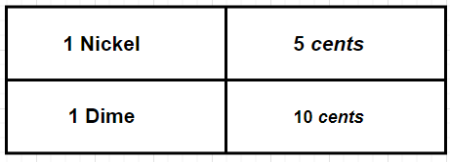
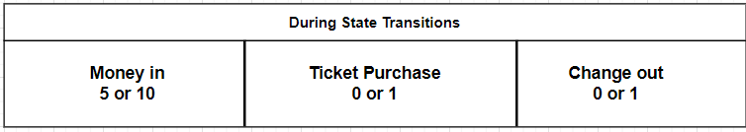
Finite State Machine Diagram
Different coin Denomination used
State Transition Numbering Order

Slide 20
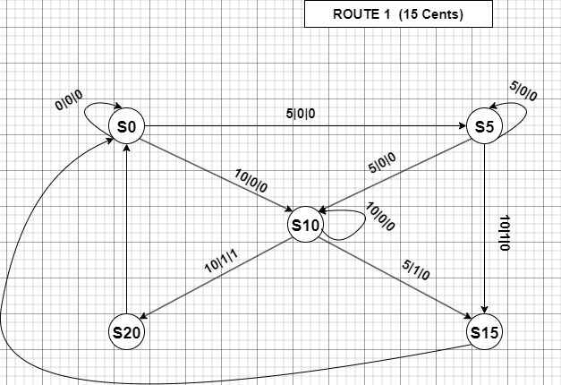
FSM for Route No. 01

Slide 21
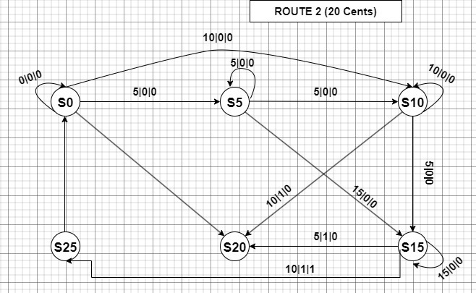
FSM for Route No. 02

Slide 22
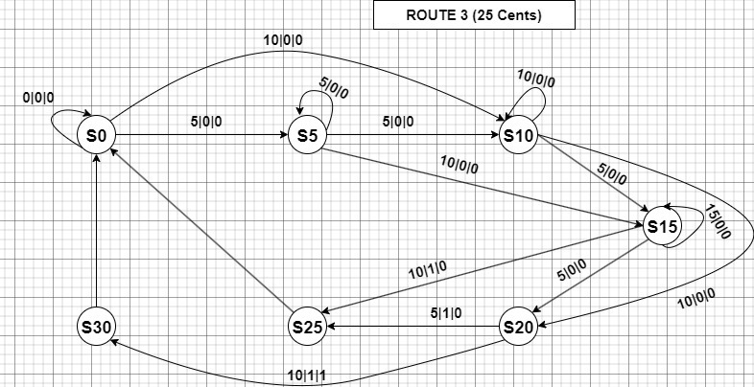
FSM for Route No. 03

Slide 23
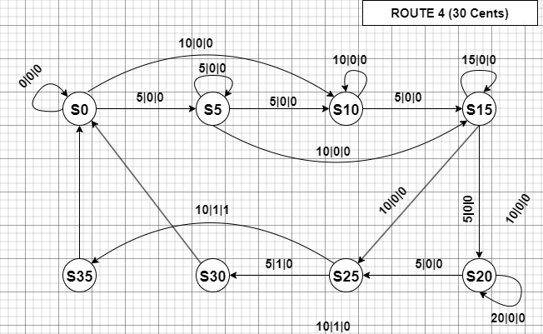
FSM for Route No. 04

Slide 24
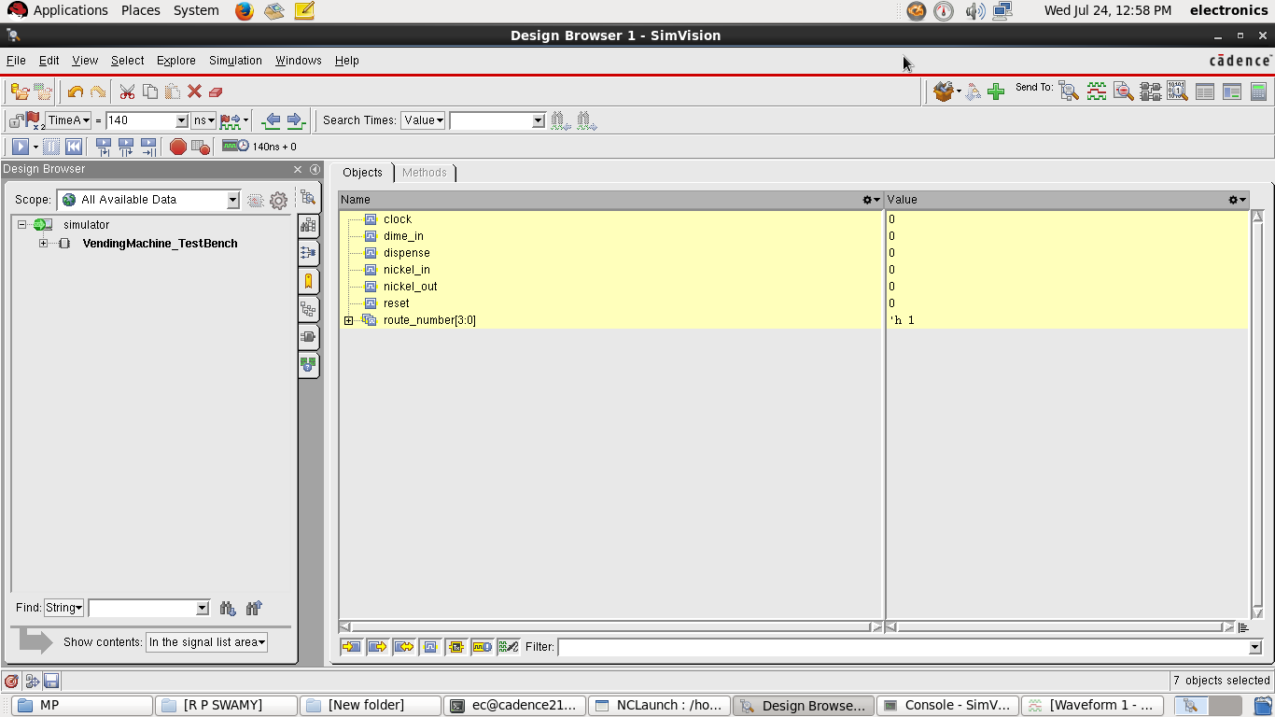
8. Verilog Design and Testbench Code
To watch the Verilog design code, [click here]
To watch the Verilog Testbench code, [click here]
9. Results: Verilog Simulation Process

Slide 25
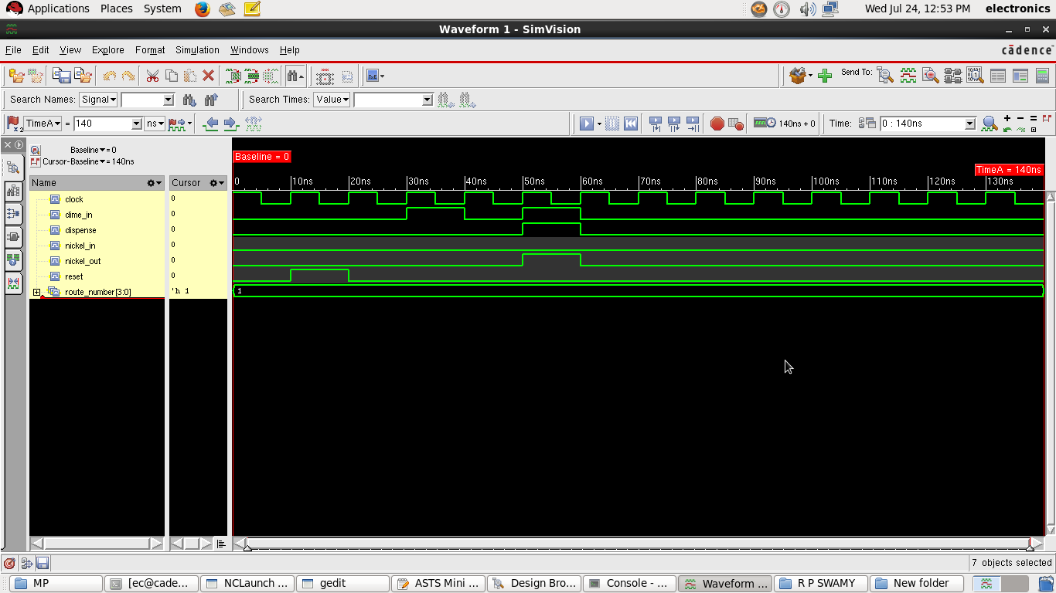
Verilog Simulation Output

Slide 26
Synopsys Design Constraint (.sdc) file
To view the constraint file, [click here]
Output files
To view the netlist file, [click here]
To view the sdc output file, [click here]

Slide 27
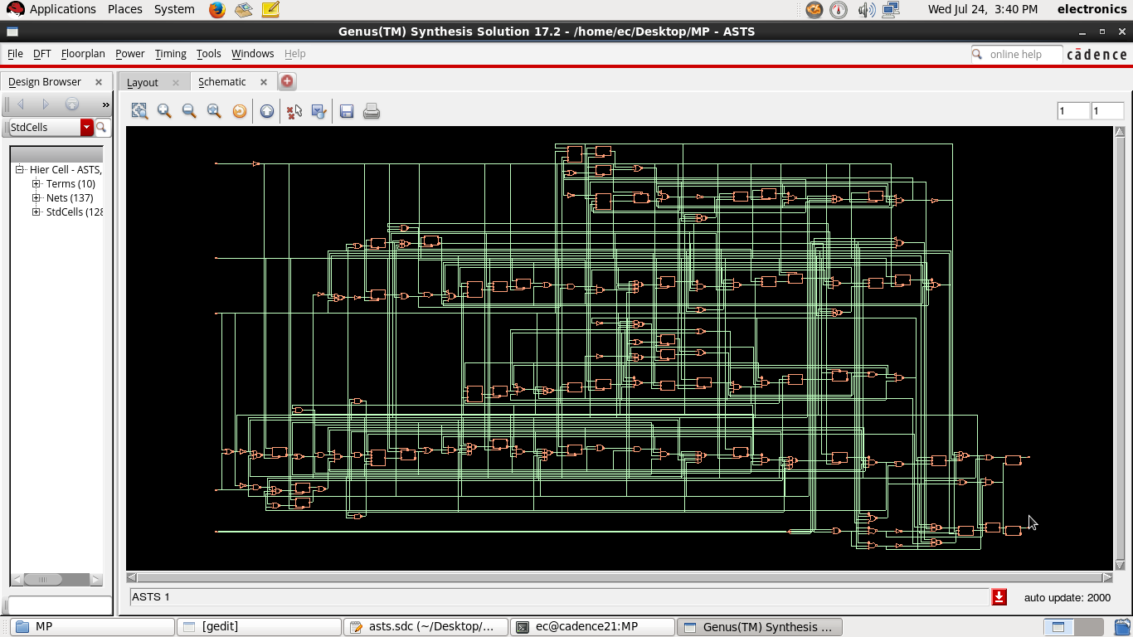
Schematic Synthesis

Slide 28
10. Generated Reports
Report on Area
(D) = wireload is default in technology library
To view the Area rpt. file, [click here]
Instance Module | Cell Count | Cell Area | Net Area | Total Area | Wireload
ASTS | 128 | 3412.886 | 0.000 | 3412.886 | <none> (D)
Report on Power
To view the Power rpt. file, [click here]
Instance | Cells | Leakage Power (nW) | Dynamic Power (nW) | Total Power (nW)
ASTS | 128 | 93.923 | 1402092.948 | 1402186.871

Slide 29
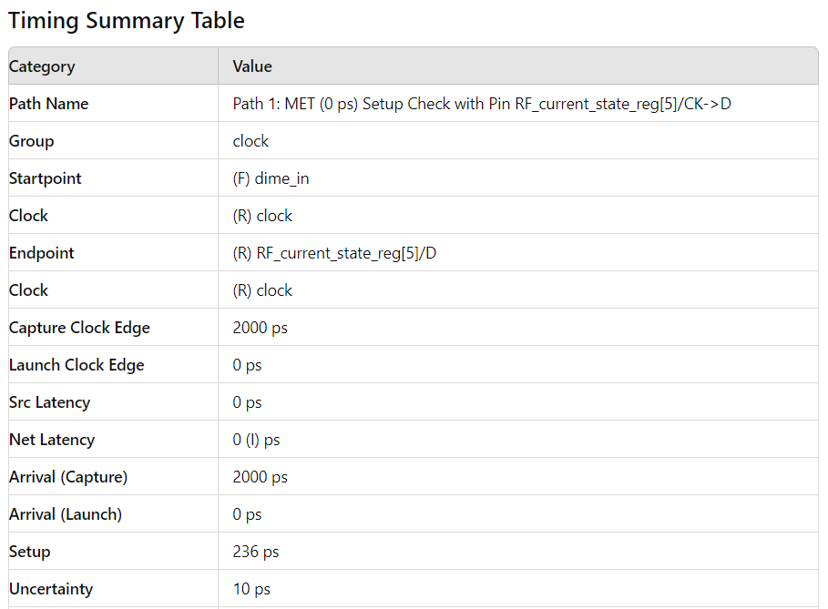
Report on Timing

Slide 30
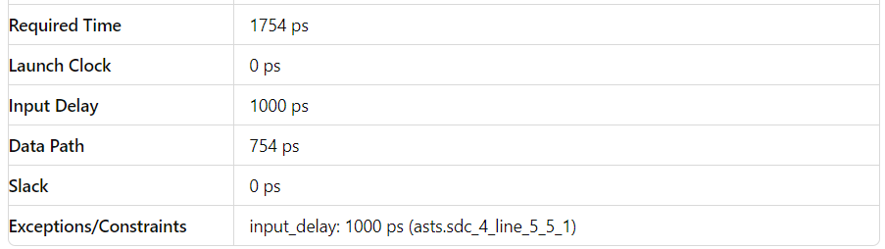
To view the Timing rpt. file, [click here]

Slide 31
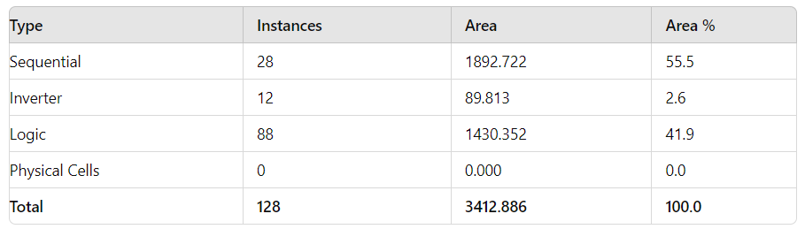
Report on Gate
To view the Gate rpt. file, [click here]

Slide 32
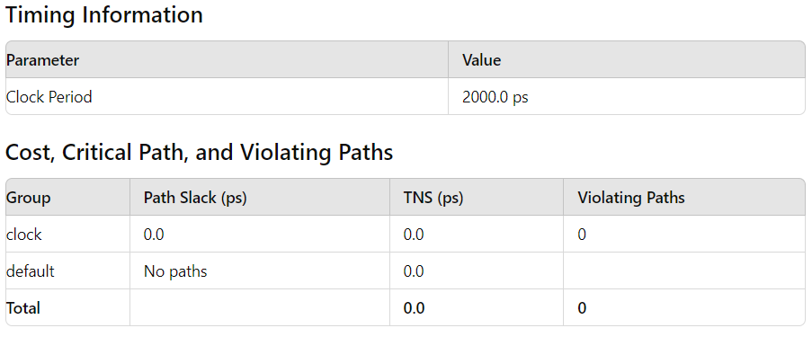
Report on Quality of Result (QoR)

Slide 33
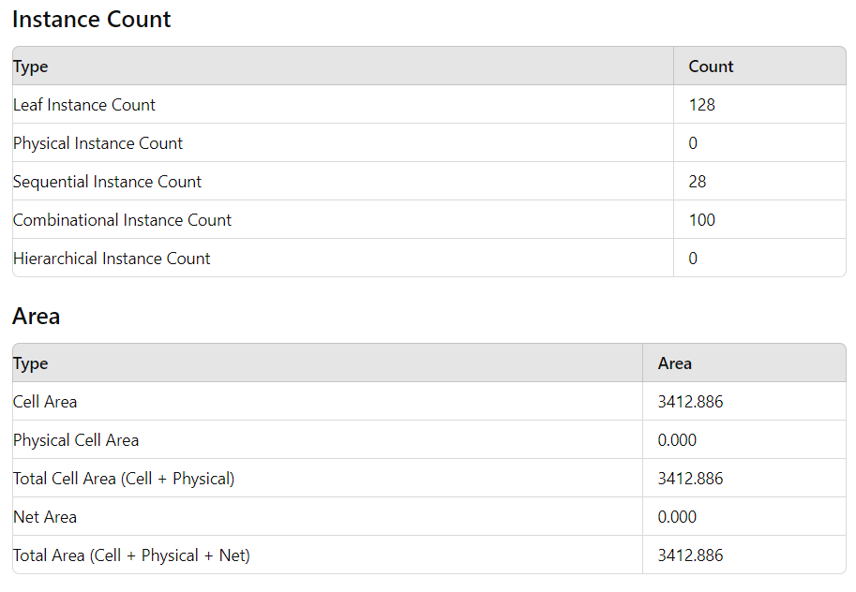

Slide 34
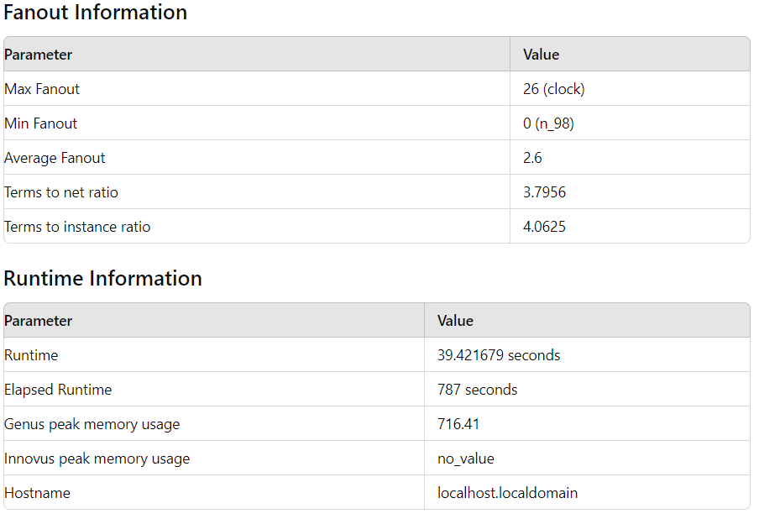
To view the QoR rpt. file, [click here]

Slide 35
11. Applications
Ticket Purchase and Validation: Enables passengers to purchase tickets and validate them at entry and exit points of the subway stations.
Improved Efficiency: Speeds up the ticketing process, reducing wait times and improving the overall passenger experience.
Data Collection: Collects data on passenger numbers, travel patterns, and peak usage times, aiding in better service planning and resource allocation.
Integration with Other Services: Can be integrated with other public transport systems and services, providing a seamless travel experience for passengers.
Security: Enhances security by controlling access to subway platforms and ensuring only ticketed passengers enter.

Slide 36
12. Advantage and Limitations
Advantages of Automatic Subway Ticketing System
Efficiency: Speeds up the ticketing process, reducing wait times for passengers.
Convenience: Provides passengers with multiple payment options, including contactless and mobile payments.
Cost Savings: Reduces the need for staffing at ticket counters and gates.
24/7 Operation: Provides continuous service without the limitations of human working hours.

Slide 37
Limitations of Automatic Subway Ticketing System
Initial Cost: High initial investment for installation and integration of the system.
Maintenance: Requires regular maintenance and updates to ensure smooth operation.
Technical Issues: Vulnerable to technical failures, which can disrupt service.
User Adaptability: Some passengers, especially the elderly or those not tech-savvy, may find it difficult to use.
Data Privacy: Collecting and storing passenger data raises concerns about privacy and data security.
Dependency on Technology: Over-reliance on technology may lead to challenges if the system fails or is hacked.
Accessibility: Must ensure that the system is accessible to all passengers, including those with disabilities.

Slide 38
13. Future Scope
We can further add a termination button to the machine. This button would allow the user to terminate the purchase process and receive all the money back sequentially.
The current system has limitations in flexibility, particularly in adjusting ticket prices and adding new routes. Addressing these gaps will enhance the system's scalability and adaptability.

Slide 39
14. Conclusion
Here are the key takeaways from the project so far:
Design and Implementation: Successfully created an automatic subway ticketing system using Verilog HDL, showcasing digital design principles.
Functionality Enhancement: Enhanced to handle multiple coin denominations and various ticket prices, increasing flexibility and user convenience.
Comprehensive Analysis: Synthesized design with detailed reports on area, gate count, QoR, timing, and power to ensure optimal performance and efficiency.
Efficiency and Reliability: Demonstrated efficient and reliable management of states like idle, coin insertion, ticket dispensing, and change return.
Future Improvements: Future work could improve scalability, integration, user interface, and security.
Overall, this mini-project demonstrated the feasibility and effectiveness of using Verilog HDL for a sophisticated and user-friendly subway ticketing system.

Slide 40
15. References
Y Sreeja, A Nikhitha, M Sruthi, P Kamalakar, and D Bhargav “Subway Automatic Ticket Booking System using Verilog”, International Open-Access, Double-Blind, Peer-Reviewed, Refereed, Multidisciplinary Online Journal, Volume 3, Issue 2, December 2023.
A. Krishna Kumar, G. Ashritha, D. Deepika, “Design of Vending Machine Using Verilog HDL”, Journal of Emerging Technologies and Innovative Research (JETIR), Volume 5, Issue 7, July 2018.
R. Kiran Kumar, “FSM Based Design on the Replication of one-hot code using Verilog HDL,” Global Jouranl of Advanced Engineering Technologies, Vol.2, Issue-3, 2013
https://github.com/Amank2854/Vending-Machine/blob/main/README.md [Date of access: 18-June-2024]
https://youtu.be/wOXs5Z_z0Ew?si=23uAR3i0PEahbd46 [Date of access: 25-June-2024]
Digital Systems Design Using Verilog with MindTap
by Charles Roth (Author), Lizy Kurian John (Author), Byeong Kil Lee (Author)

Slide 41
16. Course Outcomes
On completion of this course, students are able to
Solve the identified problems.
Analyze the available resources and their utilization.
Present the work carried out and prepare the report.
Work in a team to find the solutions for societal and technical problems.

Slide 42
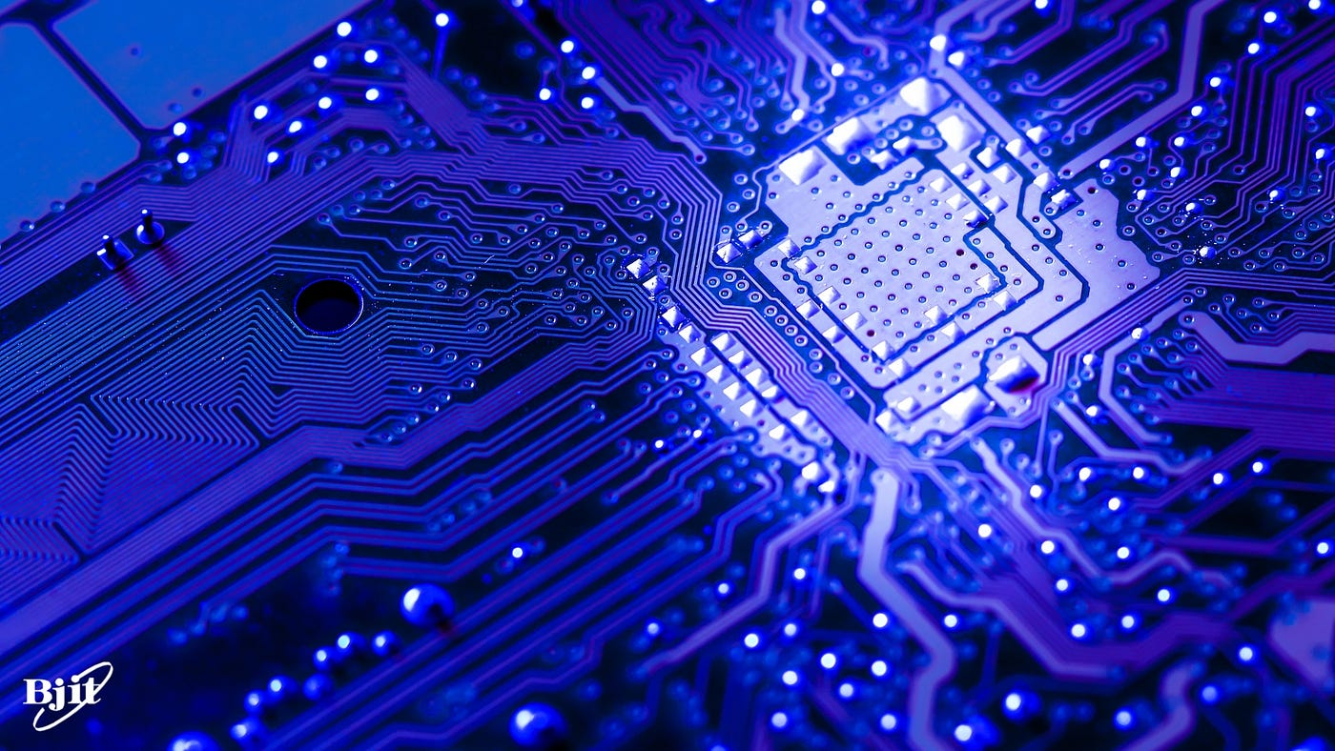
THANK YOU

